Slide 1
Instructions for use
(Formstack WCF)

Slide 2
Introduction to Online Warranty Claim form
Dear Customer
In order to facilitate easy submission of Warranty Claims we have introduced online form
We request you to keep information about your DAIKIN SAP account number (in case you don’t know pls seek information from our office),Model number, Serial number of the equipment, Part numbers, installation and trouble dates, site related or affected component picture, error codes (preferably) to apply request online,
Your request wl be processed by our RPA tool called as “Max” which will make it faster for processing to happen in our system
You will be receiving also information – acknowledgment as well as status of claim once you apply claim online
Thank you for using online Warranty claims. Any concerns pls write to us
Regards
Warranty Dept (DAME)
warranty@daikinmea.com

Slide 3
Web Access
Access Formstack link – pls use below links
1.Customers in GCC (Oman Bahrain Kuwait and African countries linked to DAME) pls use the below link
FZE Daikin Middle East - Warranty Claim Form - FZE - Formstack
“https://daikin.formstack.com/forms/service_warranty_fze”
2.Customers in UAE pls use the below link
LLC Daikin Middle East - Warranty Claim Form - LLC – Formstack
“https://daikin.formstack.com/forms/service_warranty_llc”

Slide 4
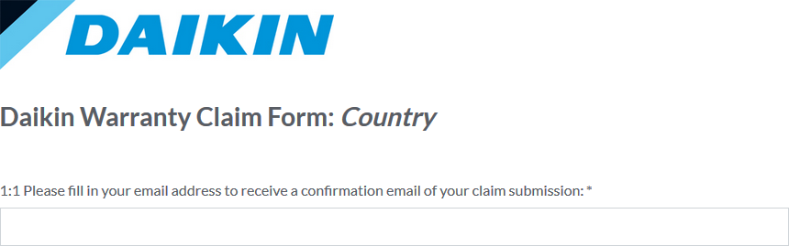
Daikin Warranty Claim Form
Please ener your email to receive a confirmation from Formstack about the form you're about to submit. Please note the asterisk (*), which denotes required fields.

Slide 5
Daikin Warranty Claim Form
This field is reserved for your warranty claim number.
This helps you trace the claim back to your customer/end-user.
Pls keep it concise and short. This is the text that will also be referenced on the Order Confirmation and Delivery Note documents, where text space is severely limited for this field.
We ask you follow the example in the field as close as possible. Please avoid long descriptions or part names.

Slide 6
Daikin Warranty Claim Form
Pls choose the claim type - "WTY".
Only select "ESV" if you are instructed to do so by your local Daikin office.

Slide 7
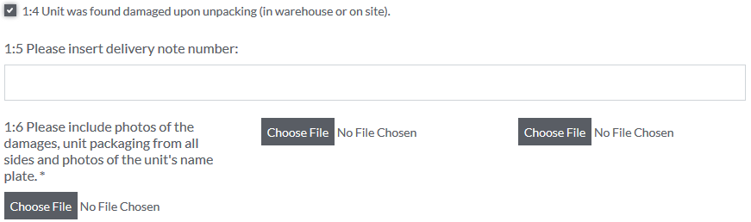
Daikin Warranty Claim Form
If the claim you are filing is for a unit that was found damaged while unloading from the delivery truck, please select 1:4 and enter the additional details, the form asks for.
The delivery note number is required as are photos of the damaged unit from all sides, also clearly showing the unit's name plate.

Slide 8
Contact information

Slide 9

Daikin Warranty Claim Form
Keep the name of your company short e.g.: COMPANY, instead of COMPANY dealing with air conditioning and heating equipment inc. The case is anyway tied to your company in our CRM system so this field only makes it easier to trace and store claim when dealing with them manually.

Slide 10
Daikin Warranty Claim Form
Your customer number is a six-digit number our SAP system assigned to you when your account was created. Each of our customers has a unique customer number. This field is extremely important as this is the company/account the warranty claim will be tied to in our system.

Slide 11

Daikin Warranty Claim Form
We also ask that you list the responsible person handling warranty claims within your company.

Slide 12
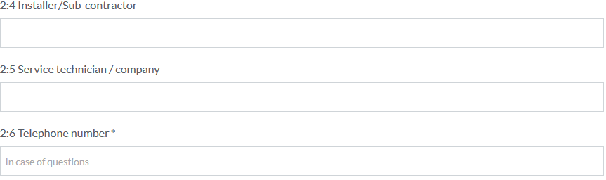
Daikin Warranty Claim Form
Additionally, we ask for some information regarding the installation company. While these fields are not mandatory it's useful information.
We also ask for a phone number so we know who to contact in case of further questions.

Slide 13
Delivery address

Slide 14
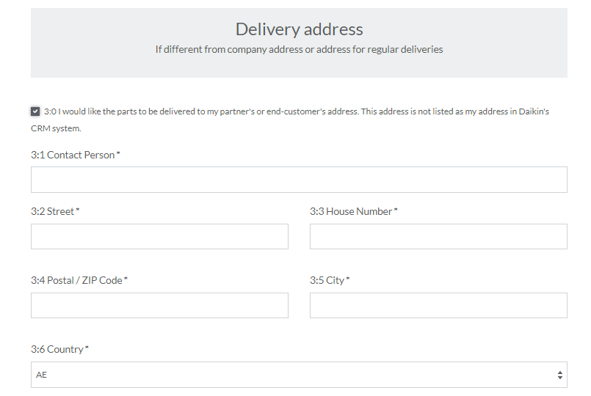
Daikin Warranty Claim Form

Slide 15
Product information

Slide 16
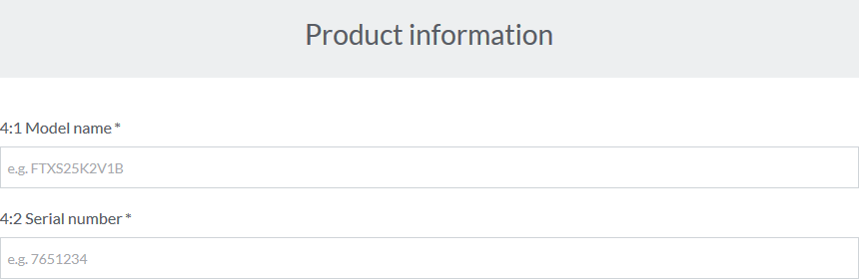
Daikin Warranty Claim Form
Obviously the most important fields on the claim: The model name and serial number. These must match the unit's name plate to the letter – all letters and numbers must be included. This is crucial
For example if your model is FDMRN20AV1K and you only type e.g. FDMRN20 it will be rejected by the system, which means your claim will be automatically rejected as well.

Slide 17
Installation / Trouble details

Slide 18
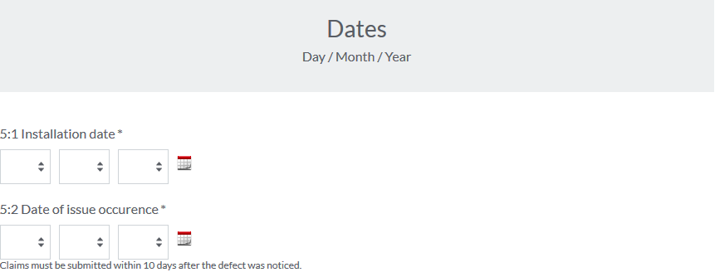
Daikin Warranty Claim Form
Here, follow the below rules (which is the logic in system)
Installation date – Date at which the Equipment got installed – it should be technically after the delivery date in our system.
Date of issue occurrence also “Trouble date” must not be more than 30 days before the current date. Which means you should lodge your claims preferably within 30 days

Slide 19
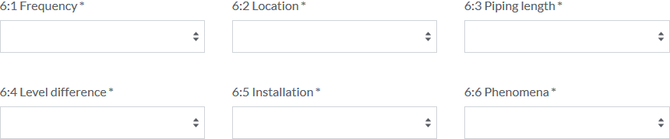
Daikin Warranty Claim Form
You must select the options from the dropdown lists which suit your claim as closely as possible.
When you are applying claim for Compressor these information 6.2 to 6.6 will be mandatory
If, for example, the fan motor broke in the outdoor unit, it doesn't really matter at what level difference the indoor and outdoor units are installed at, so you may leave that on "not applicable/other".

Slide 20
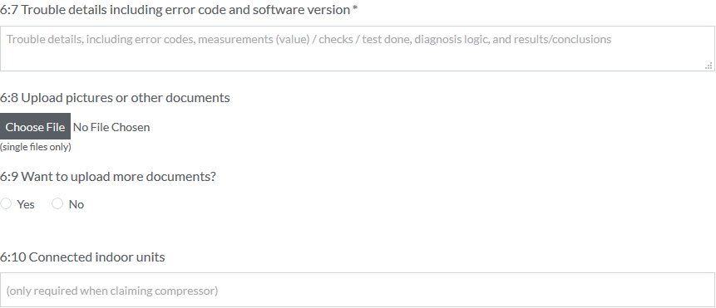
Daikin Warranty Claim Form
This field is also crucial to the validity of the claim – you must describe what is wrong with the unit and how you (or the service technician) came to this conclusion.
Pls try to provide this information as much as possible

Slide 21
Daikin Warranty Claim Form
If relevant, you may upload additional photos from the site or unit.
When claiming a compressor, we ask that you list the indoor unit type as well.

Slide 22
Required parts

Slide 23
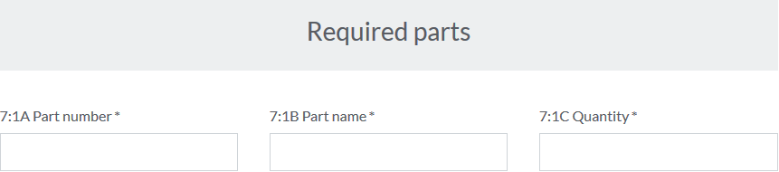
Daikin Warranty Claim Form
Last but not least, you are to use the Spare Parts Bank (SPB) to find the correct replacement part for your unit and list the parts here. Be sure to select all the parts you need – there are several lines, not only one, as shown here.
If you don’t know or have access to Daikin Spare Parts Bank pls write to parts@daikinmea.com to get access with your Address and contact details.
Quick tip: Don't forget about the capacity adapter!

Slide 24
Submit

Slide 25
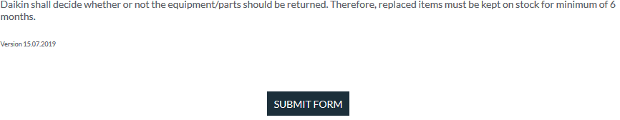
Daikin Warranty Claim Form
We continually strive to improve our products and sometimes, the best sources of information are the parts that have broken down. For this reason, we ask that the original parts are kept on stock, should we request their return.
After all of the information has been filled in, please press the submit button so that the claim is transferred to us.

